Slide 1
Neural Surface Reconstruction
ShanghaiTech
2022.10.10

Slide 2
Outline
Geometry Representation
Level sets
Sign distance function
Density representation based Volume Rendering
NeuS
SDF based Volume Rendering
Bias problem
Opaque density derivation
Occlusion Problem
Opacity derivation
Loss Function
Results

Slide 3
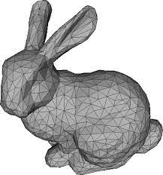
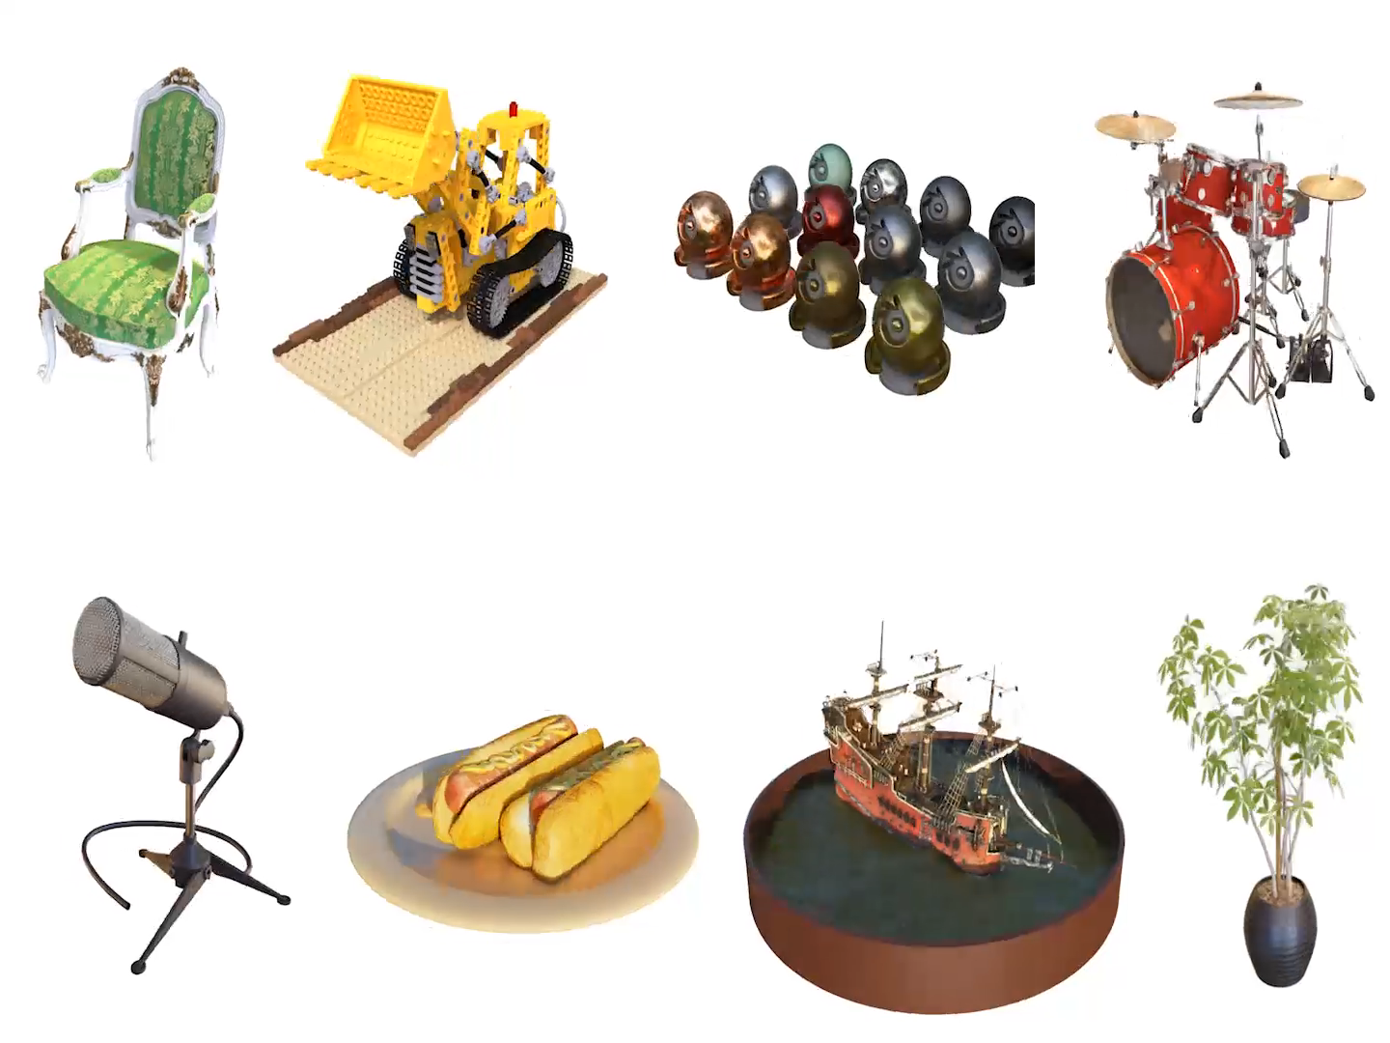
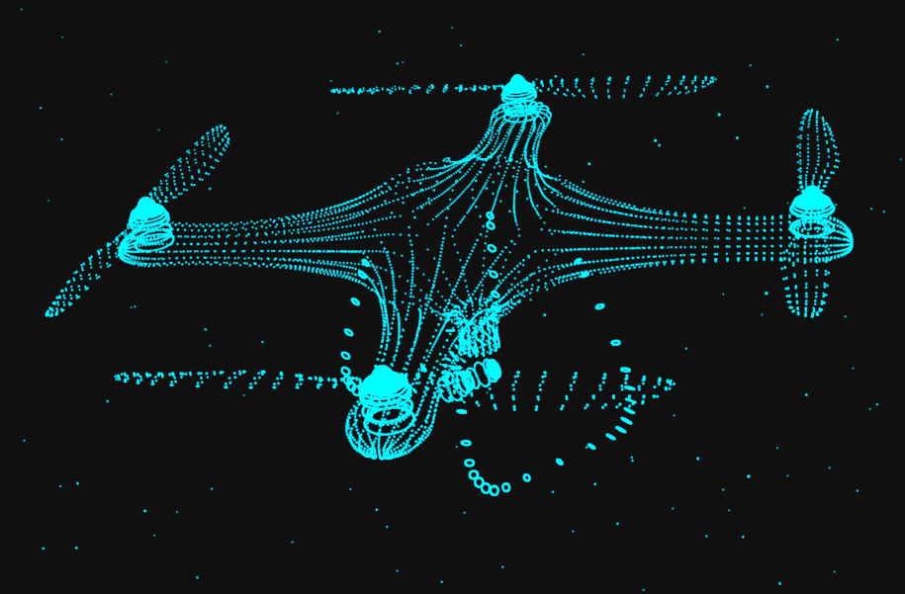
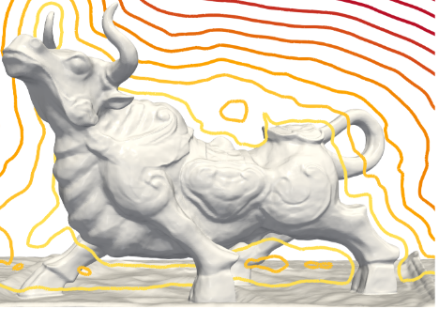
Geometry Representation
Discrete Representation
Triangle mesh, pointcloud…
Continuous Representation
Signed Distance Function, Neural Radiance Field…
Mesh
Pointcloud
Sign Distance Function
Neural Radiance Fields

Slide 4
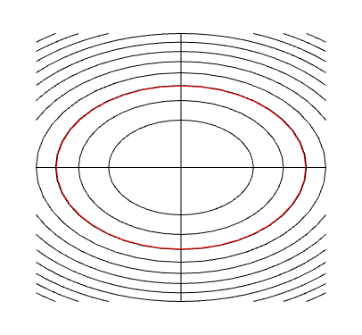
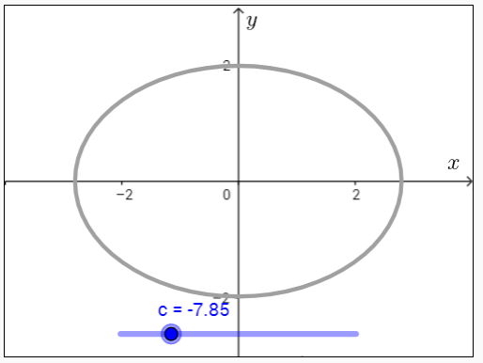
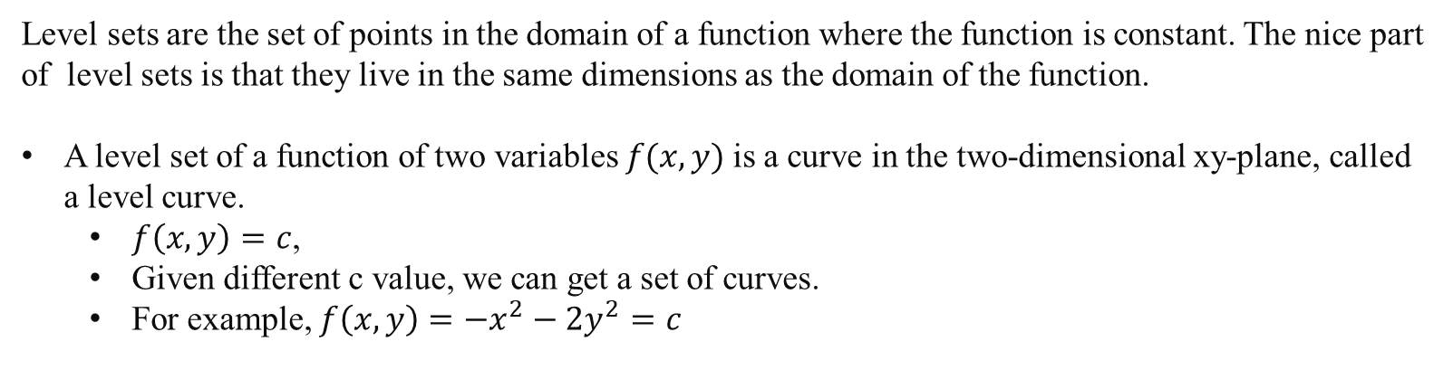
Level Sets
Level sets are the set of points in the domain of a function where the function is constant. The nice part of level sets is that they live in the same dimensions as the domain of the function.
A level set of a function of two variables $f(x,y)$is a curve in the two-dimensional xy-plane, called a level curve.
$f\left(x,y\right)=c$,
Given different c value, we can get a set of curves.
For example, $f\left(x,y\right)=−x^{2}−2y^{2}=c$
2D Level Curves Visualize at https://mathinsight.org/applet/level_curve_elliptic_paraboloid

Slide 5
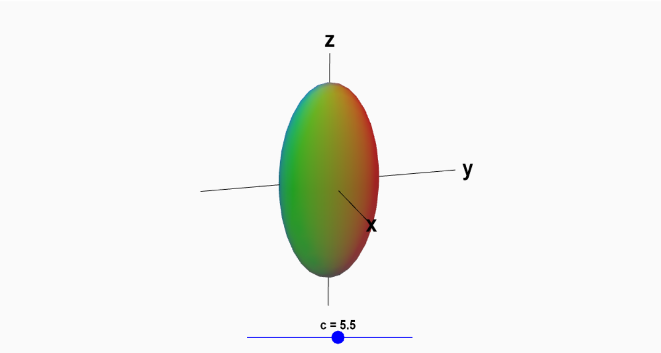
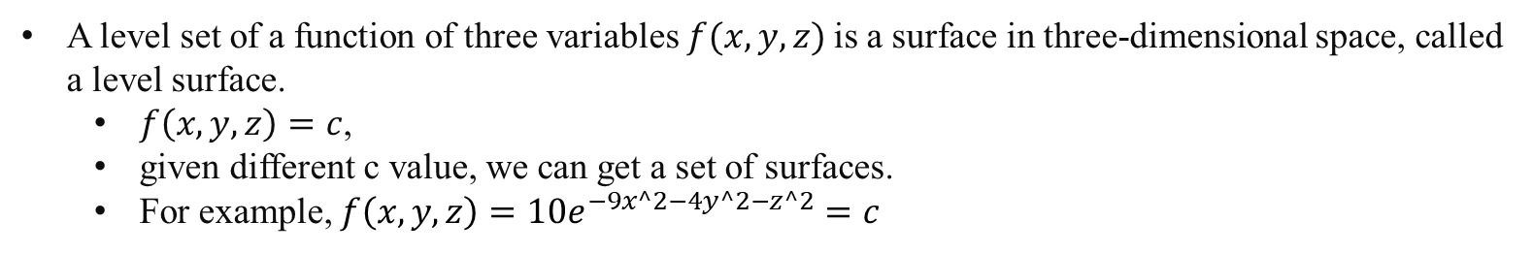
Level Sets
A level set of a function of three variables $f(x,y,z)$is a surface in three-dimensional space, called a level surface.
$f\left(x,y,z\right)=c$,
given different c value, we can get a set of surfaces.
For example, $f\left(x,y,z\right)=10e^{−9x^2−4y^2−z^2}=c$
3D Level Surface at https://mathinsight.org/applet/level_surface_function_three_variables

Slide 6
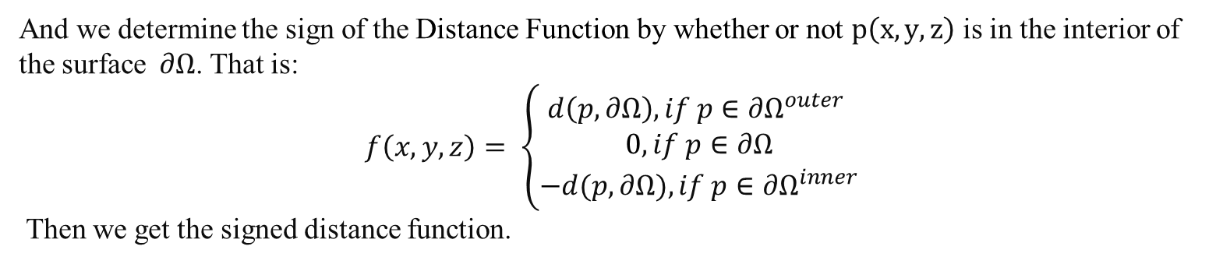
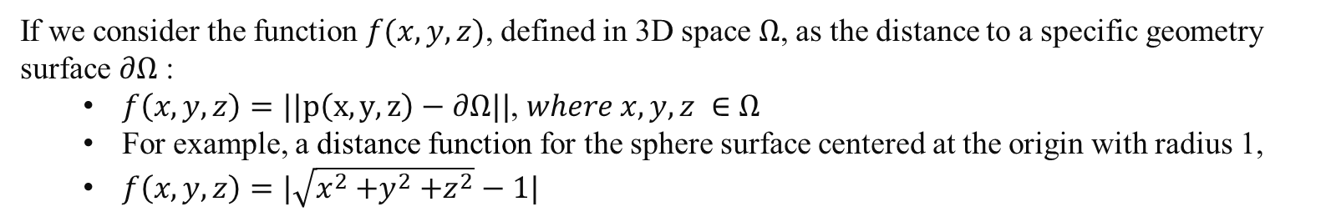
Signed Distance Function (SDF)
If we consider the function $f(x,y,z)$, defined in 3D space $Ω$, as the distance to a specific geometry surface $∂Ω$ :
$f\left(x,y,z\right)=||p\left(x,y,z\right)−∂Ω||$, $where x,y,z ∈Ω$
For example, a distance function for the sphere surface centered at the origin with radius 1,
$f\left(x,y,z\right)=|\sqrt{x^{2}{+y}^{2}+z^{2}}−1|$
And we determine the sign of the Distance Function by whether or not $p\left(x,y,z\right)$ is in the interior of the surface$∂Ω$. That is:
$$f\left(x,y,z\right)= \left\{\begin{aligned}d\left(p,∂Ω\right), if p∈{∂Ω}^{outer} \\ 0, if p∈∂Ω \\ −d(p,∂Ω), if p∈{∂Ω}^{inner}\end{aligned}\right.$$
Then we get the signed distance function.

Slide 7
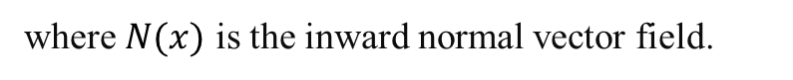
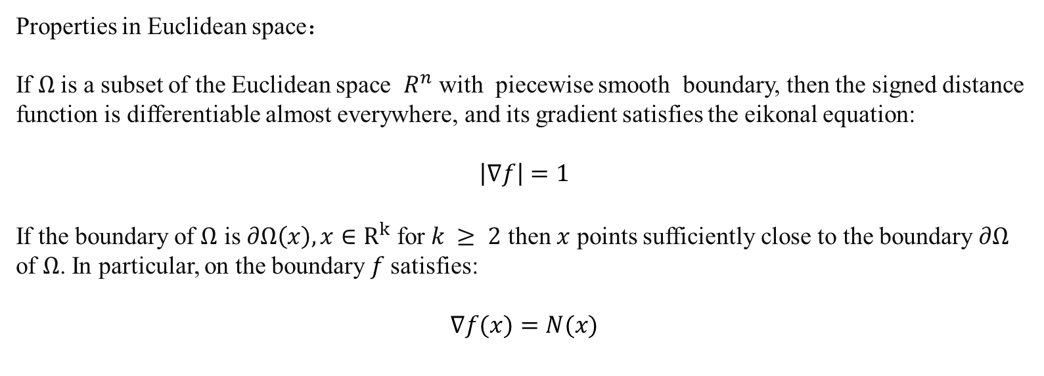
Signed Distance Function (SDF)
Properties in Euclidean space：
If $Ω$is a subset of the Euclidean space $R^{n}$ with piecewise smooth boundary, then the signed distance function is differentiable almost everywhere, and its gradient satisfies the eikonal equation:
$$\left|∇f\right|=1$$
If the boundary of $Ω$ is $∂Ω\left(x\right), x∈R^{k}$ for $k ≥ 2$ then $x$ points sufficiently close to the boundary $∂Ω$ of $Ω$. In particular, on the boundary $f$satisfies:
$$∇f(x)=N(x)$$
where $N(x)$ is the inward normal vector field.

Slide 8
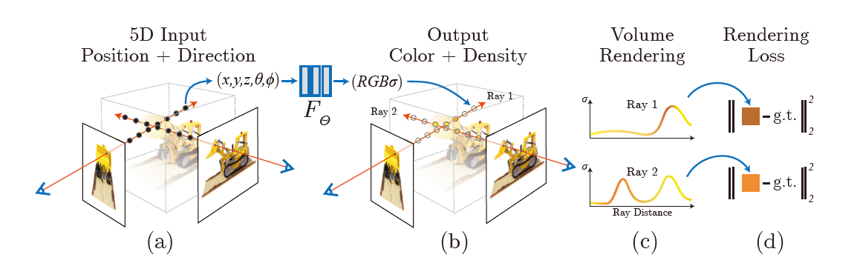
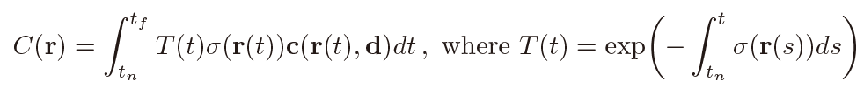
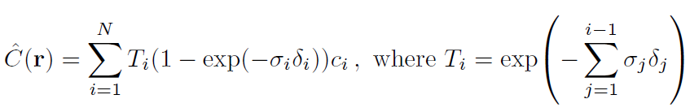
Density Representation
Rendering Equation:
Or:

Slide 9
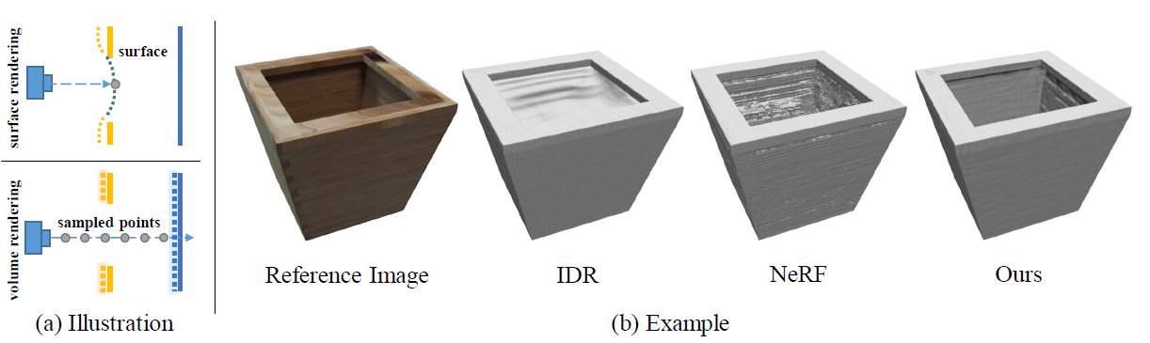
NeuS
NeuS: Learning Neural Implicit Surfaces by Volume Rendering for Multi-view Reconstruction

Slide 10
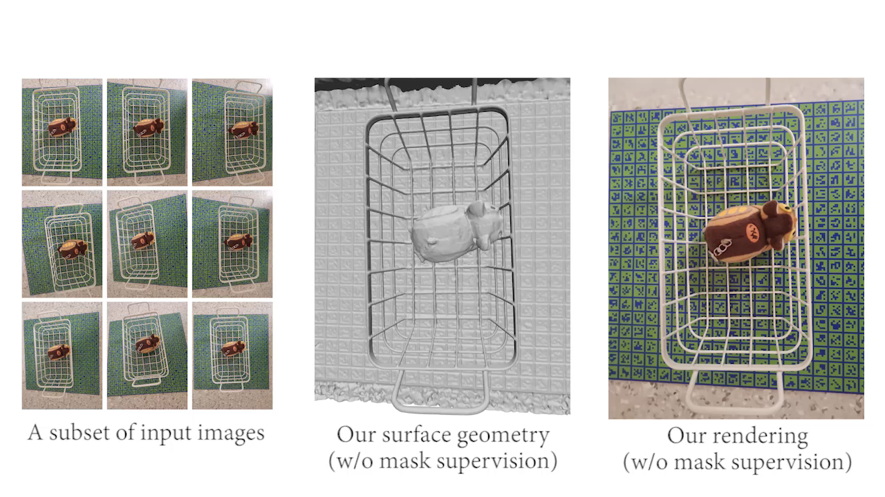
NeuS
Sampled Result from NeuS:

Slide 11
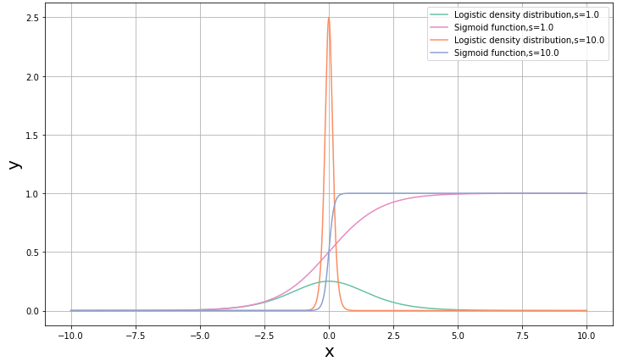
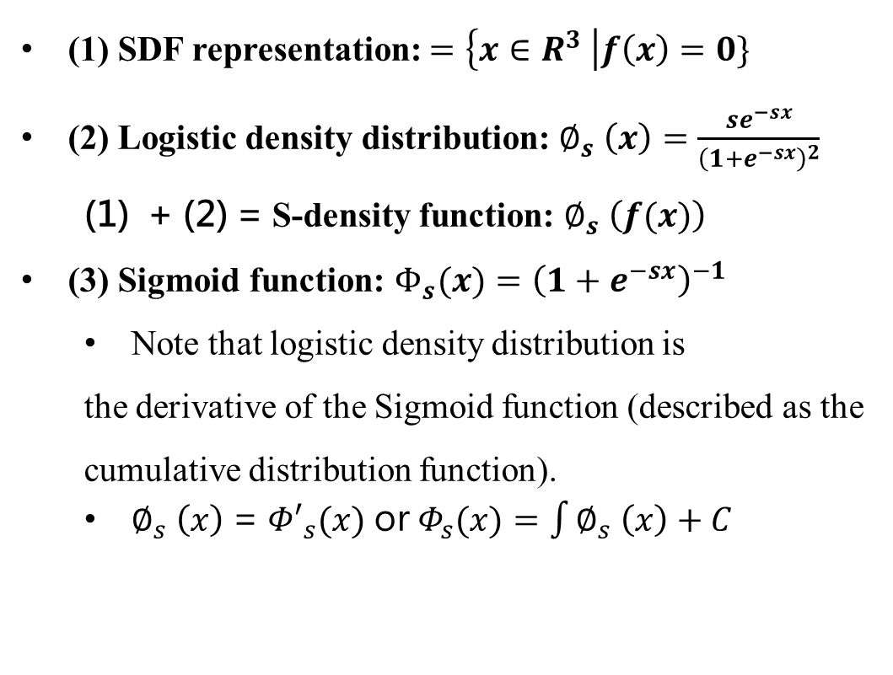
Volume Rendering Based on SDF Representation
Preliminary Equations in NeuS:
(1) SDF representation: $=\left\{x∈R^{3} \right|f\left(x\right)=0\}$
(2) Logistic density distribution: $∅_{s} \left(x\right)=\frac{se^{−sx}}{{\left(1+e^{−sx}\right)}^{2}}$
+ (2) = S-density function: $∅_{s} \left(f(x)\right)$
(3) Sigmoid function: $Φ_{s}(x)={\left(1+e^{−sx}\right)}^{−1}$
Note that logistic density distribution is
the derivative of the Sigmoid function (described as the cumulative distribution function).
$∅_{s} \left(x\right)$ = ${Φ′}_{s}(x)$ or $Φ_{s}(x)=\int{∅_{s} \left(x\right)+C}$

Slide 12
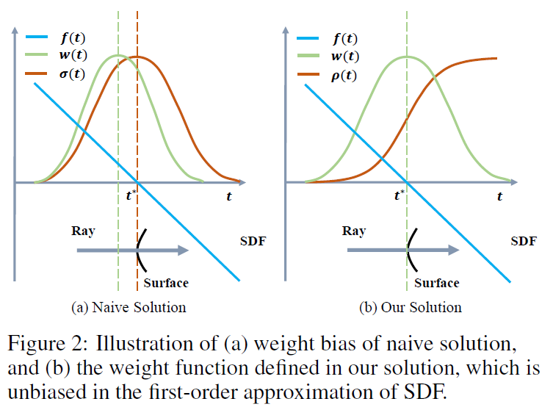
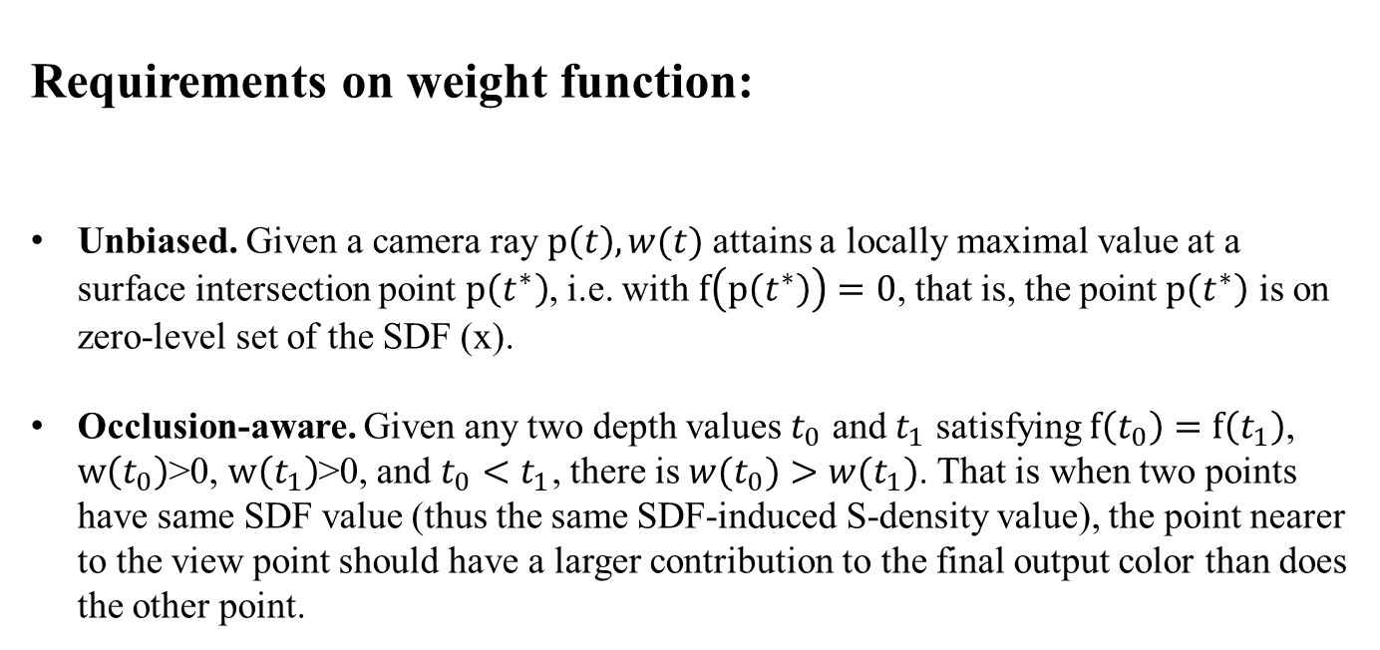
Volume Rendering Based on SDF Representation
Requirements on weight function:
Unbiased. Given a camera ray $p\left(t\right), w(t)$ attains a locally maximal value at a surface intersection point $p\left(t^{∗}\right)$, i.e. with $f\left(p\left(t^{∗}\right)\right)=0$, that is, the point $p\left(t^{∗}\right)$ is on zero-level set of the SDF (x).
Occlusion-aware. Given any two depth values $t_{0}$ and $t_{1}$ satisfying $f\left(t_{0}\right)=f\left(t_{1}\right)$, $w\left(t_{0}\right)$>0, $w\left(t_{1}\right)$>0, and $t_{0}<t_{1}$, there is ${w(t}_{0})>w(t_{1})$. That is when two points have same SDF value (thus the same SDF-induced S-density value), the point nearer to the view point should have a larger contribution to the final output color than does the other point.

Slide 13
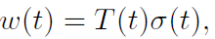
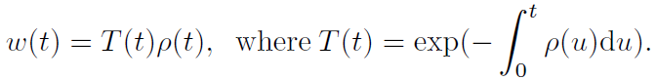
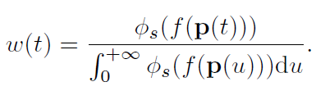
Volume Rendering Based on SDF Representation
Bias Problem in NeRF:
In NeRF
(accumulated transmittance)
(volume density)
How to construct an unbiased weight function?
In NeuS
(directly uses the normalized S-density as weights)
(How to define?)

Slide 14
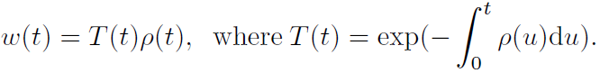
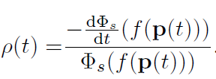
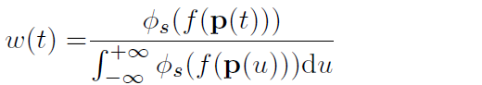
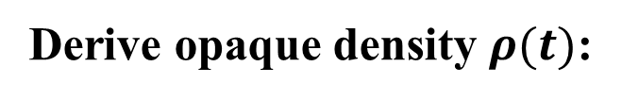
Volume Rendering Based on SDF Representation
Derive opaque density $ρ(t)$:
We will first consider a simple case where there is only one surface intersection, and the surface is simply a plane.
Equation 1:
Equation 2:

Slide 15
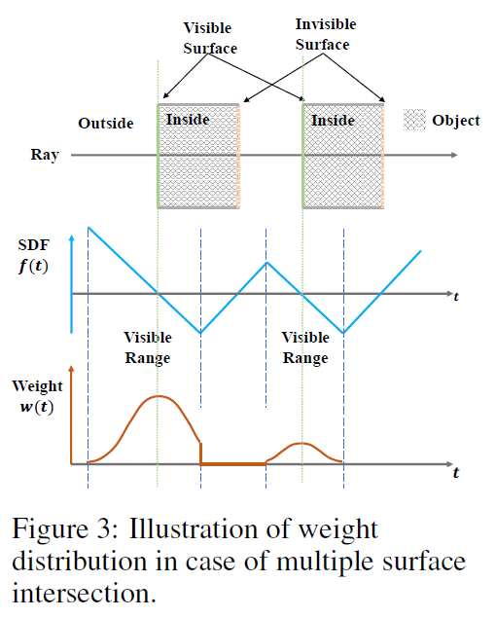
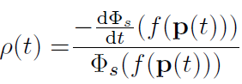
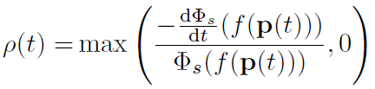
Volume Rendering Based on SDF Representation
Occlusion Problem in NeuS
single surface intersections:
(becomes negative on the segment of the ray with increasing SDF values)
multiple surface intersections:

Slide 16
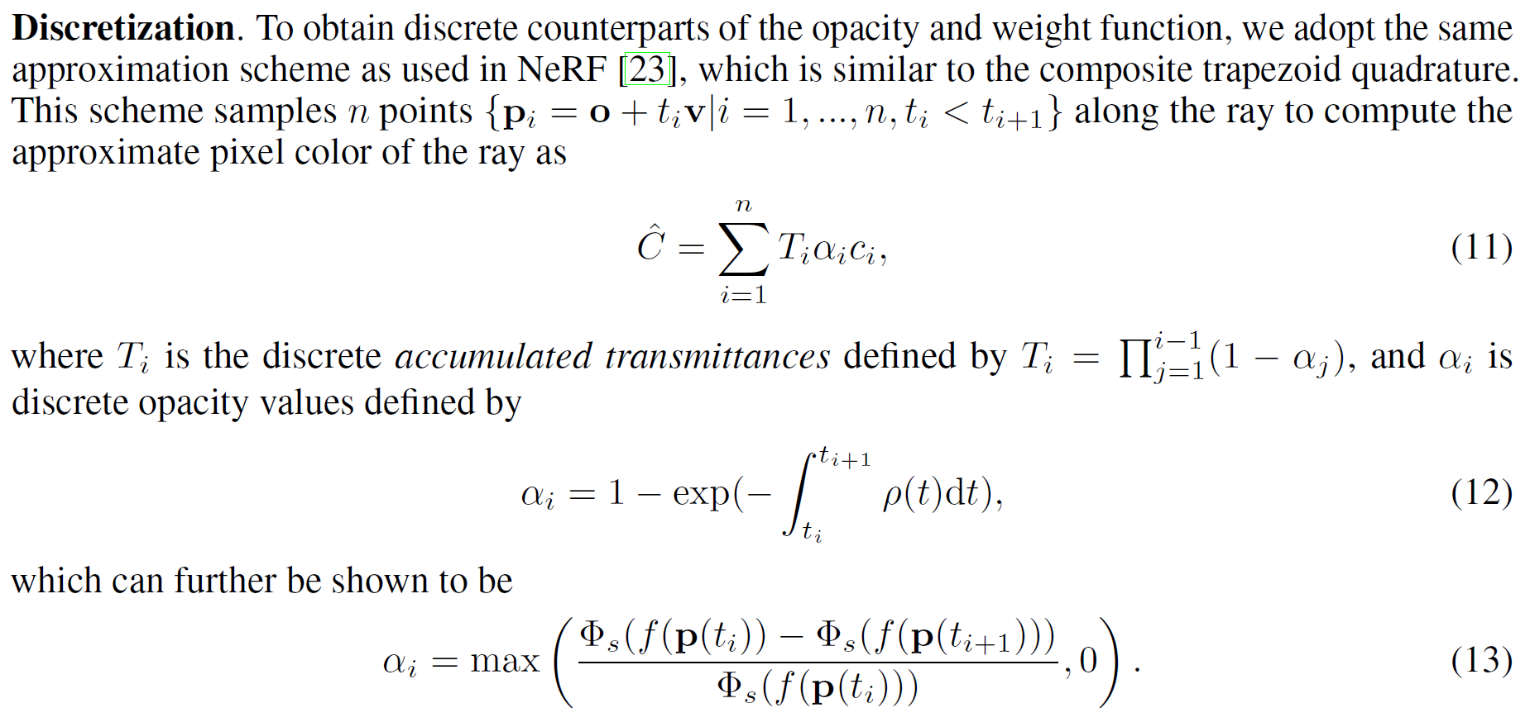
Volume Rendering Based on SDF Representation

Slide 17
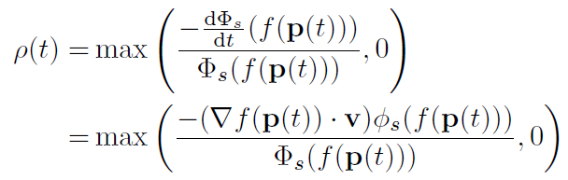
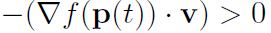
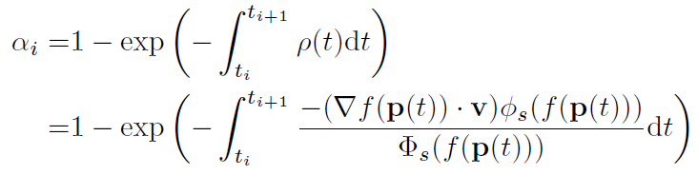
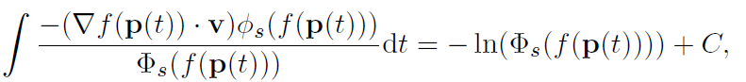
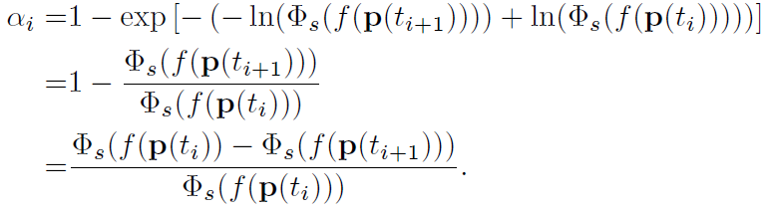
Volume Rendering Based on SDF Representation
1.
consider the case where the sample point interval [ti , ti+1] lies in a range [tl, tr] over which the camera ray is entering the surface from outside to inside.
2.
Primitive function
3.

Slide 18
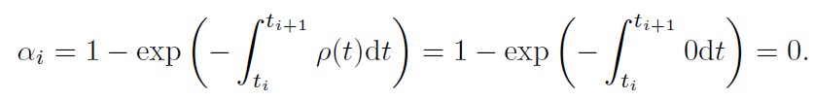
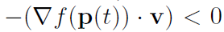
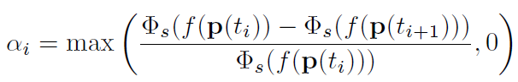
Volume Rendering Based on SDF Representation
4.
Next consider the case where the sample point interval [ti , ti+1] lies in a range [tl, tr] over which the camera ray is entering the surface from inside to outside.
5.

Slide 19
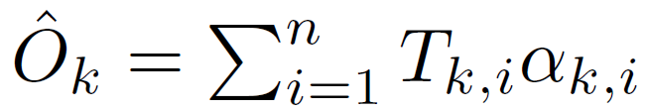
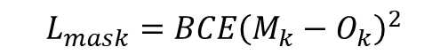
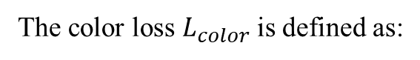
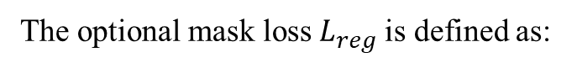
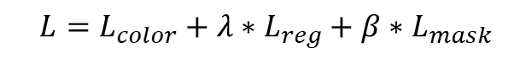
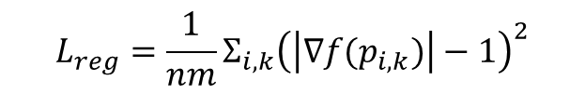
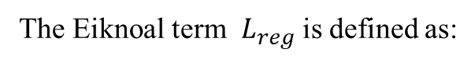
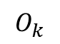

Loss Function
The loss function is defined as:
$$L=L_{color}+λ∗L_{reg}+β∗L_{mask}$$
The color loss $L_{color}$is defined as:
$$L_{color}=\frac{1}{n}Σ_{i}R(C_{r,i} −C_{gt,i})$$
The Eiknoal term $L_{reg}$is defined as:
$$L_{reg}=\frac{1}{nm}Σ_{i,k}{\left(\left|∇f{(p}_{i,k})\right|−1\right)}^{2}$$
The optional mask loss $L_{reg}$is defined as:
$$L_{mask}=BCE{\left(M_{k}−O_{k}\right)}^{2}$$
Where
$$O_{k}$$

Slide 20
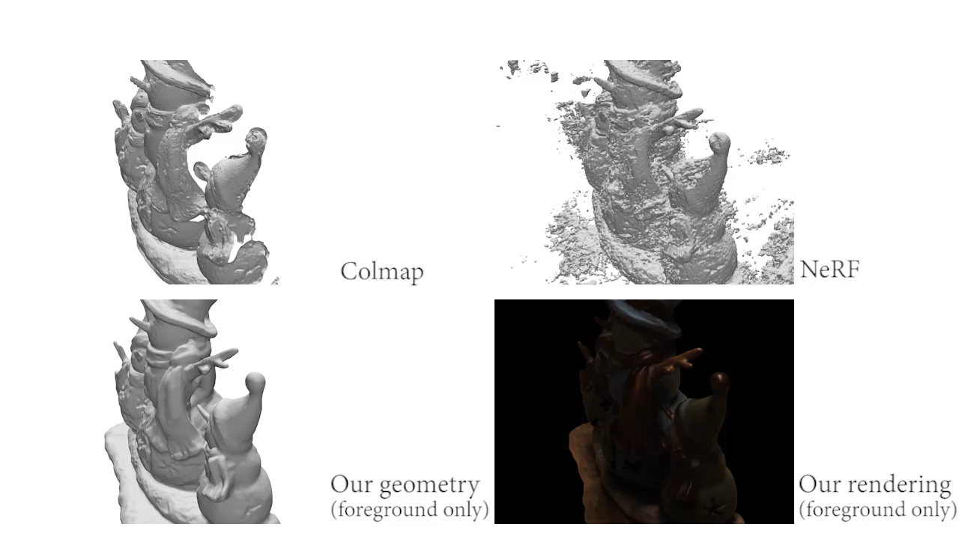

Results

Slide 21

Results

Slide 22

Results

Slide 23
Thanks!

